Slide 1
Extra: Demo for Heat Equation Example Workflow
Fork repository (once)
Clone the fork (once)
Create and checkout branch
Base branch on current development or other appropriate version for each feature
Modify and commit code
Push change to fork
Issue pull request to upstream repository
Review pull request
CI testing (covered in upcoming module)

Slide 2
Git Workflow for the Heat Equation Example
Developers
Work on feature branches in their forks
Using forks requires contributors to have only read-access to primary repository
Issue pull requests for changes
Natural opportunity to review and test all changes
Pull requests
Are reviewed by at least one developer (not the author)
Undergo CI testing prior to merging

Slide 3
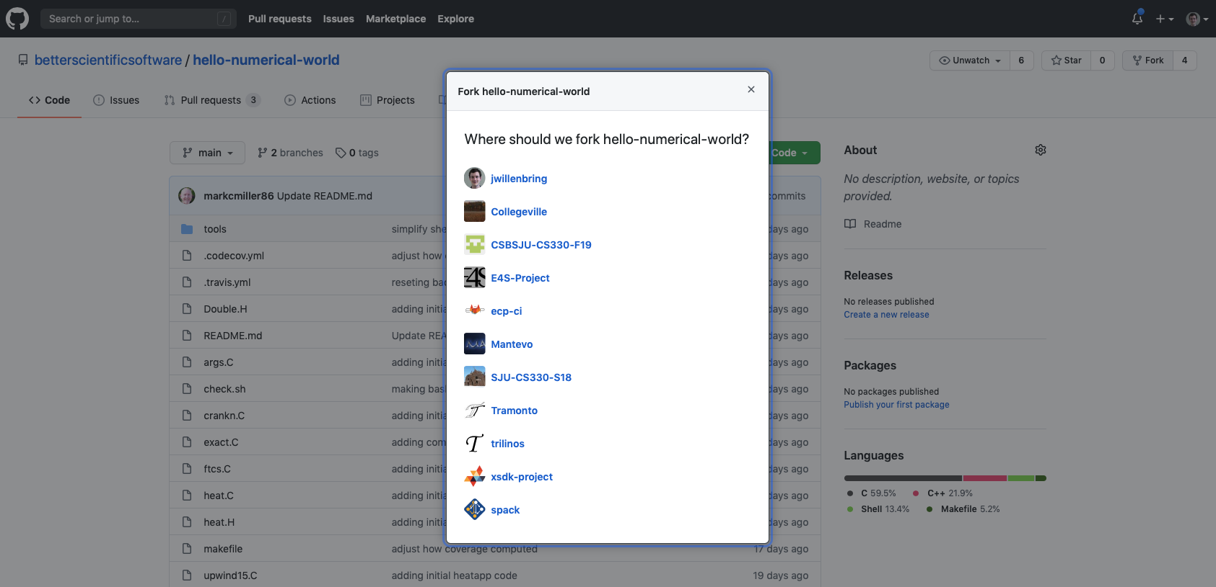
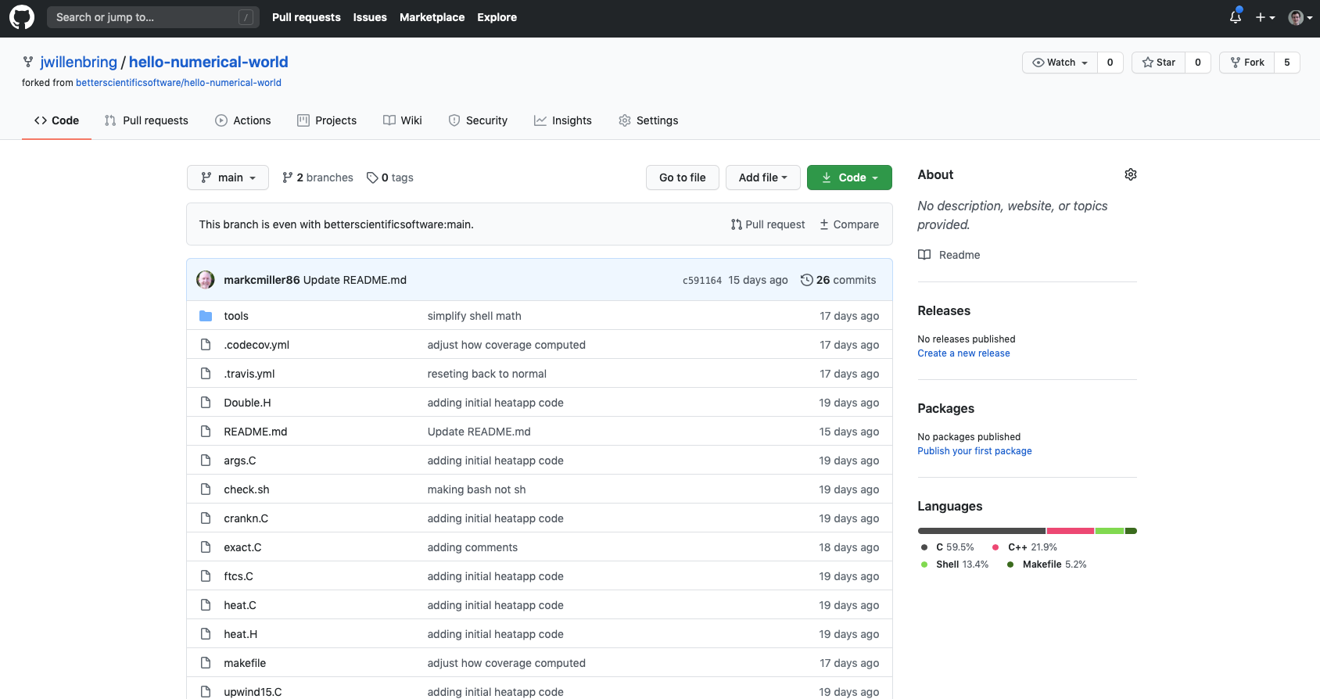
Fork the Repository

Slide 4
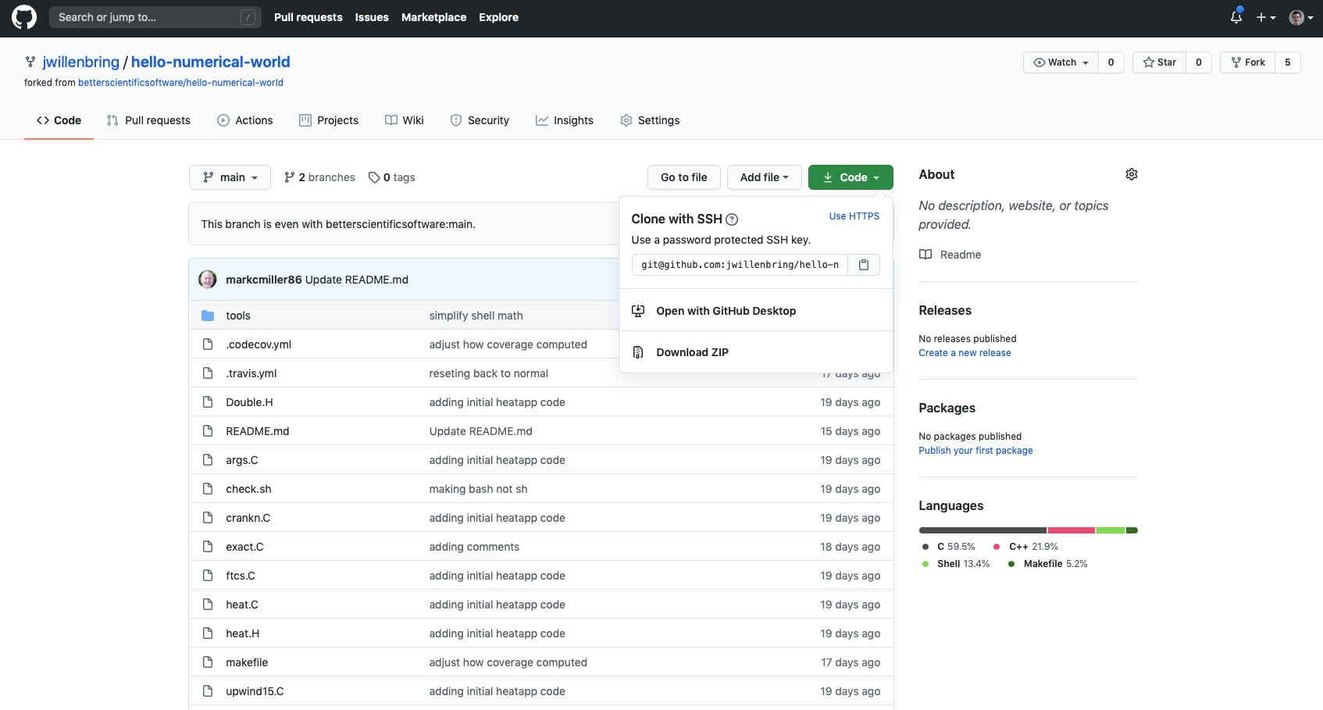
Find the Path to Clone

Slide 5
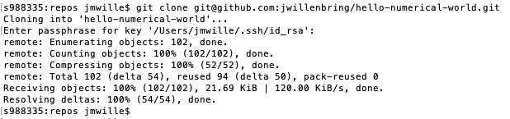
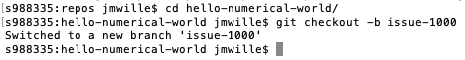
Clone the fork; Create and Checkout a New Branch

Slide 6
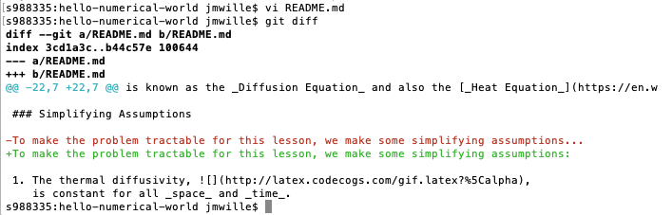
Modify and Commit Code

Slide 7
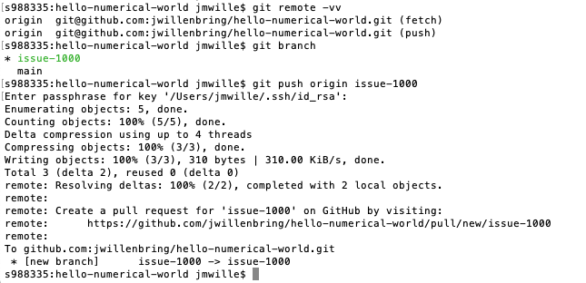
Push Change to Fork

Slide 8
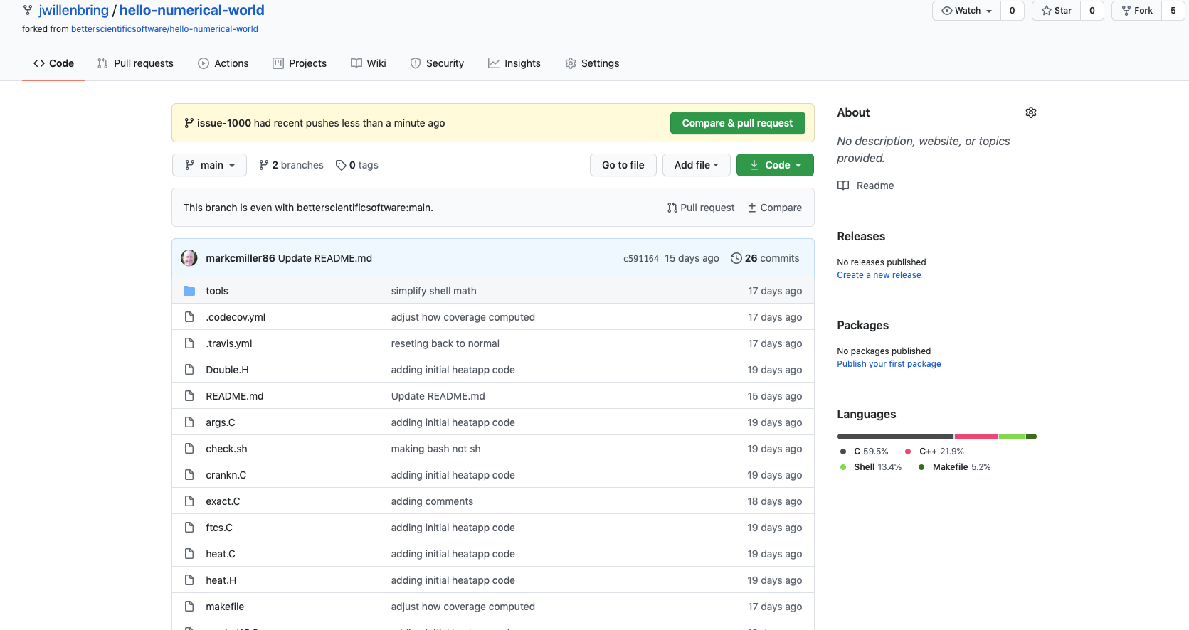
Issue Pull Request to Upstream Repository

Slide 9
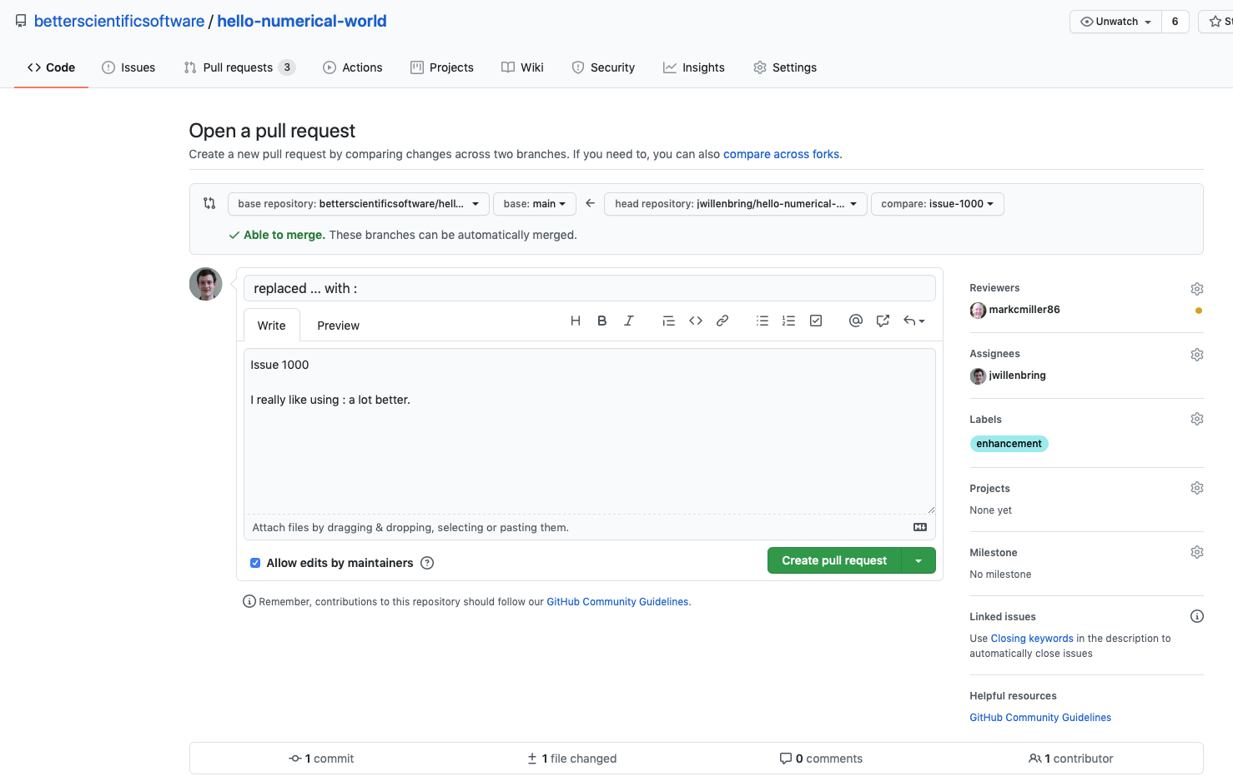
Issue Pull Request to Upstream Repository

Slide 10
Review Pull Request

Slide 11
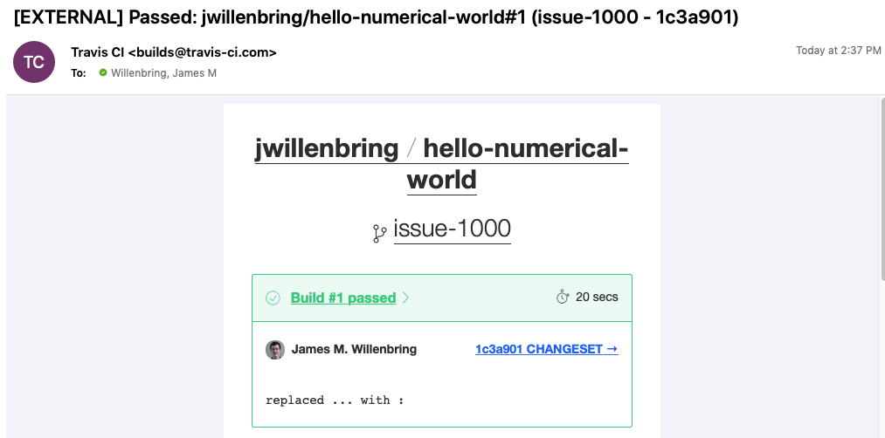
CI Testing for PR
This will be covered in the CI module

